Slide 1
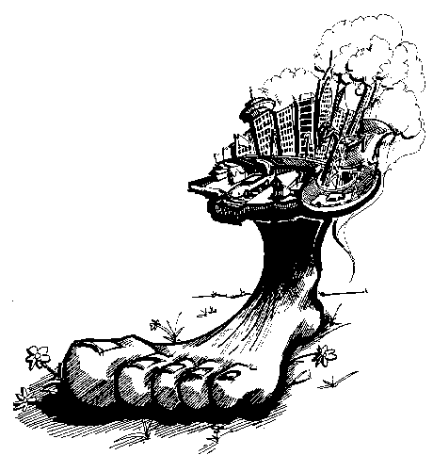
Ecological Footprint
Alysha Woodman
Ernesto Vargas
Rebeca Tormo
Valeria Garro

Slide 2
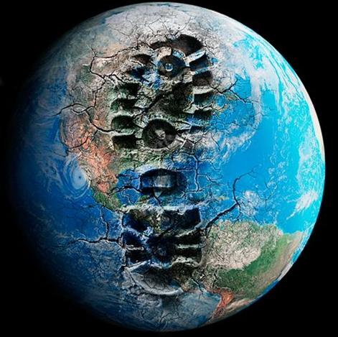
What is it?
An area of land (and water) that would be required to sustainably provide for a specific population’s resources and assimilate its wastes
It is more about the resources and wastes produced or needed by a population rather than the population that an area can sustain
Inverse of carrying capacity
Provides a quantitative estimate of
human carrying capacity

Slide 3
How do countries compare?
Country | Hectares | Football fields
United States | 10.3
Australia | 9.0
Canada | 7.8 | 15
Germany | 5.3
United Kingdom | 5.2
Switzerland | 5.1
China | 1.6
India | 0.8

Slide 4
How do countries compare?
Countries are either
Ecological debtors
  Larger footprints
  Changing sizes of the countries in proportion
  Could be harvesting resources unsustainably, importing goods or exporting wastes
Ecological creditors
  Smaller footprints than biocapacity
  Biocapacity: living capacity or natural resources

Slide 5
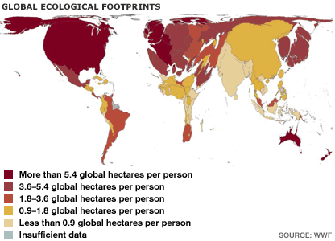

Slide 6
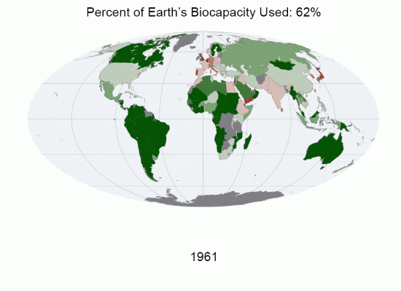

Slide 7
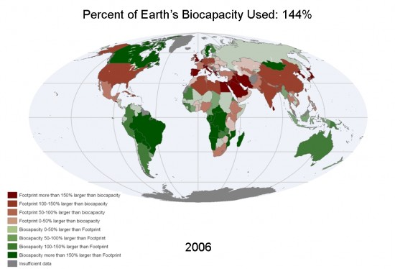

Slide 8
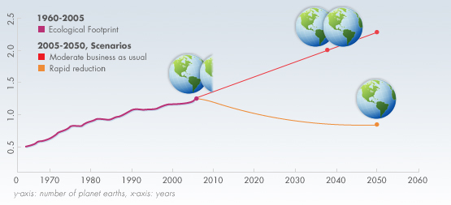

Slide 9
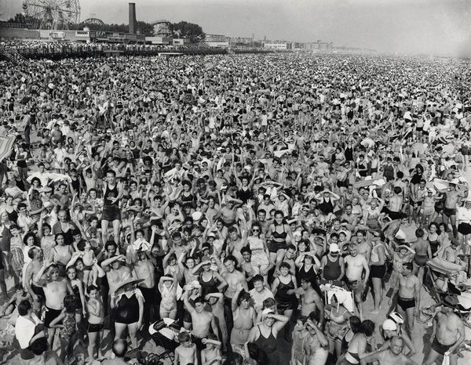
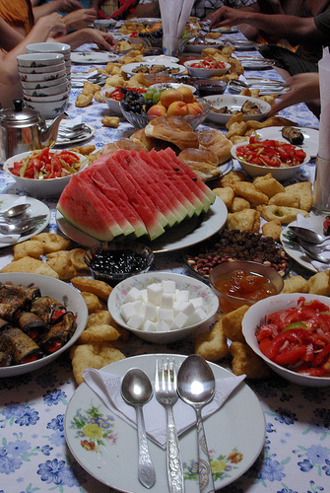
Depends on…
Population size (how many people and how much land each one uses)
Consumption per capita

Slide 10
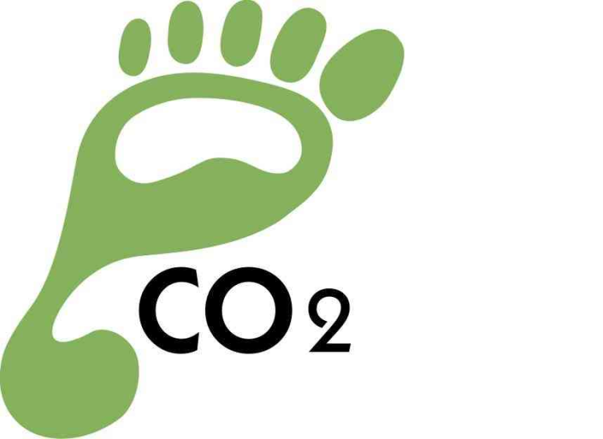
Calculating ecological footprints
Convert various kinds of consumption and waste production into a land area needed to produce or service it.
4 main areas:
Fossil fuels and energy consumption
Food land
Forest products
Land required for towns, roads and factories(consumed land)

Slide 11
Formulae
Websites take these formulas into account to calculate each person’s footprint.
Energy land: fuel used in gigajoules/population X energy area (y ha/cap)
Food land: area of cropland and pasture/population
(w ha/cap)
Forest land: wood products (mass or volume)/population X productivity (z ha/cap)
Consumed land: area of consumed land/population
(x ha/cap)

Slide 12
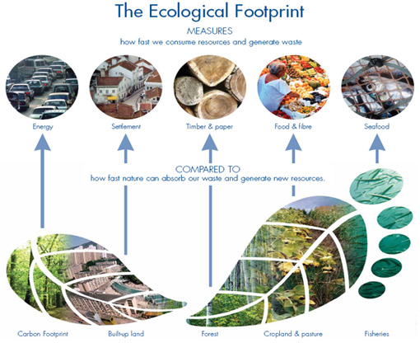

Slide 13
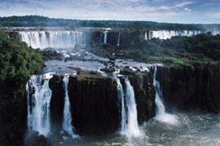
How useful is it?
Indicator of sustainability
Conceptual simplicity
Clear indicator of progress towards sustainability
Clear indicator of resource injustice
National footprint comparisons

Slide 14
Limitations
Average, therefore it doesn’t show whether there are areas dense in waste or resources or completely virginal natural areas
Does not capture other environmental strains for example, once the resources are used they may not be reused for a while (systematic degradation of ecological productivity)
Ignores the effects of toxic or air pollution
They fail to capture the erosion of earth carrying capacity, which is a basis of sustainability

Slide 15
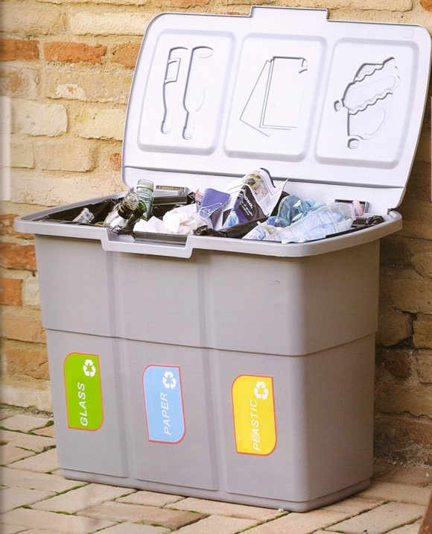
Recycling
At home and at work:
  Classify everything you have
  in separate bins
    Paper/cardboard
    Plastic
    Glass
    Aluminum
  Find out about recycling programs near where you live or work
  Leave you bins in the appropriate area so that it can be collected properly

Slide 16

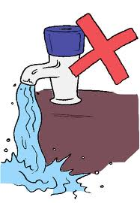
Resource conservation
What YOU can do:
  Water your lawn with a water hose instead of water sprinklers, they spray water not needed by the plants
  Participate in community recycling programs
  Buy products manufactured with recycled materials
  Reuse bottles and paper as much as possible
  Say no to plastic bags in the supermarket
  Do not buy/use products containing CFC’s

Slide 17
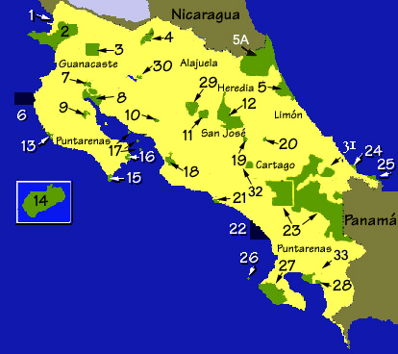
A country:
  Limit the amount of pollution and carbon emissions in factories
  Limit the amount of fishing and hunting a person can do
  National parks and reserves, wildlife refugees
  Promote the sell of environmental friendly products (grant subsidies to companies)
  Organize recycling programs
  Establish laws protecting the environment and for conserving resources
  Make ecological limits central to decision-making

Slide 18
Calculate your own footprint!
Footprint Calculator

Slide 19
http://www.footprintnetwork.org/en/index.php/GFN/page/calculators/

Slide 20
Thank you!

